Slide 1
DRUG USE WORLDWIDE AND HIV
JULIA BUXTON

Slide 2
RELIABILITY OF DRUG USE DATA
Arcane, century old prohibition regime: criminalization, stigma
Law enforcement approach: quantitative, metrics
‘Measure what they treasure’ not IMPACTS
Poor data for policy evaluation / programming

Slide 3
CONTEXTS OF DATA COLLATION
Criminalisation: Hidden populations, informal economies, cognitive bias
Drug control architecture: organic /synthetic bias
UNODC reporting / national survey capacities
Reliability and robustness of methods
Capturing extent, nature, harms, benefits and characteristics over time

Slide 4
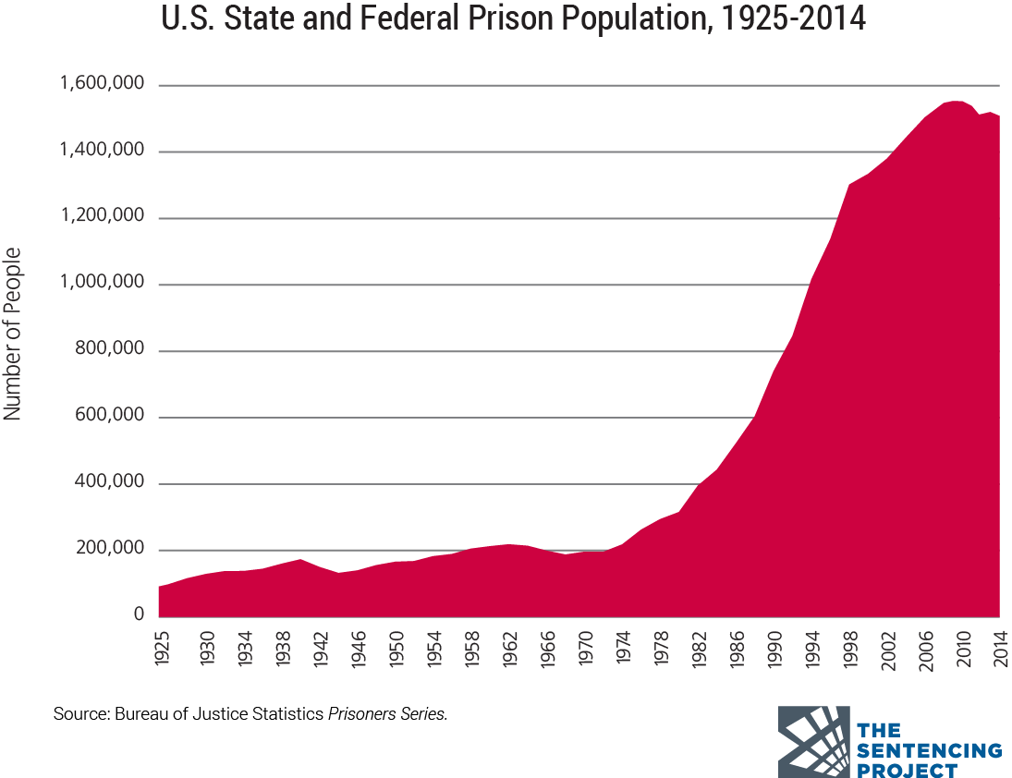
The Data: 2018 World Drug Report
Global high: 275m people (5.6% global population) used drugs at least once 2016
31m ‘suffer from drug use disorder’
1 in 6 with dud
received
‘treatment’ (2016)
Women as 1 in 5

Slide 5
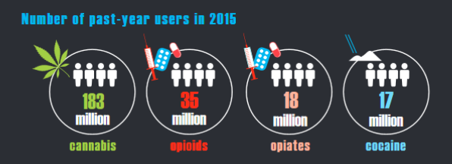
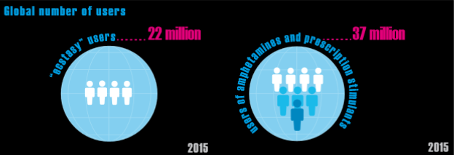

Slide 6
PWID
PWID (10.6m): ½ in China, Russia and US
1 in 5 are women, 1 in 4 under 24 y/o
20% of new HIV inflections (2015)
1 in 2 live with hepatitis C
1 in 8 live with HIV
Only: 79 countries have both NSP and OST
4 have provision to scale
34 have HIV testing for PWID
162 no information on ART

Slide 7
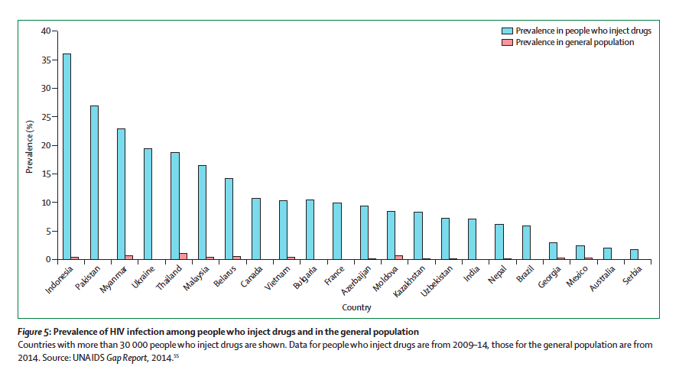
PREVALENCE OF HIV INFECTION:
PWID AND GENERAL POPULATION
Notes:
Countries with more than 30,000 PWID are shown. Data for PWID are from 2009-14, those for the general population are from 2014. Source UNAIDS Gap report

Slide 8
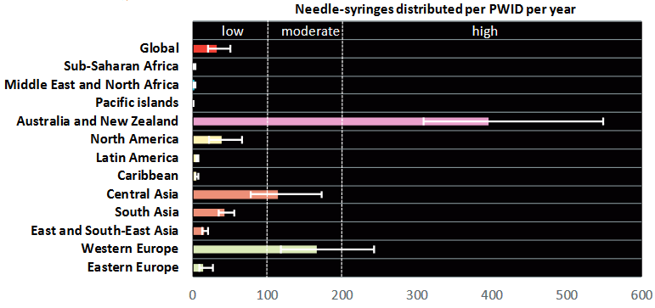
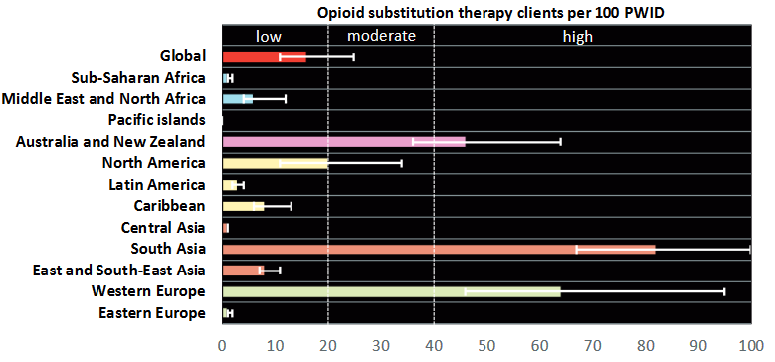
S. Larney et al, The Lancet Global Health, vol. 5, No. 12 (2017)

Slide 9
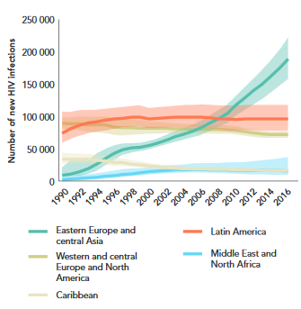

Slide 11
WDR 2018, p 20
Given the hidden and stigmatized nature of injecting drug use, it is extremely challenging to arrive at accurate and valid population size estimates for PWID and the prevalence of HIV among PWID in a given country

Slide 12
HOLISTIC POLICY FAILURE
Opium poppy cultivation - 420,000 ha, coca cultivation - 213,000 ha
Global opium production up 65% 2016-2017: 10,500 tons
Global cocaine manufacture up 56% 2013–2016 - 1,410 tons
247 tonnes of ATS seized
450,000 drug use deaths (WHO)

